Slide 1
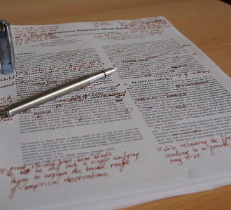
Revising Your Paper…
Making it sound better!
This Photo by Unknown Author is licensed under CC BY

Slide 2
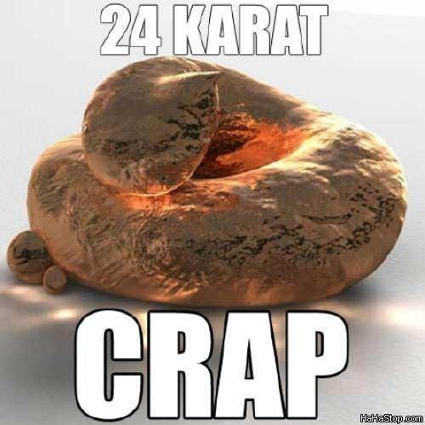
The First Draft…
The first draft of any piece of writing should be a piece of CRAP!!!!
It will not be perfect!
It should not be perfect.
Not even seasoned writers, write a perfect first draft!

Slide 3
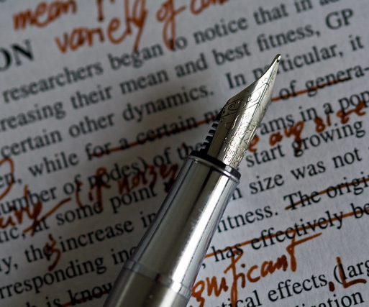
Revising Drafts
Rewriting is the essence of writing well—where the game is won or lost.
—William Zinsser
The Writing Center, University of North Carolina at Chapel Hill

Slide 4
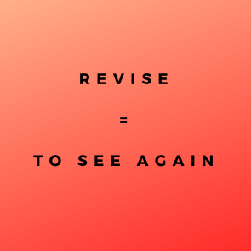
What does it mean to revise?
Revision literally means to “see again,”
  to look at something from a fresh, critical perspective.
It is an ongoing process of rethinking the paper:
  reconsidering your arguments,
  reviewing your evidence,
  refining your purpose,
  reorganizing your presentation,
  reviving stale prose.
The Writing Center, University of North Carolina at Chapel Hill

Slide 5

Why is revision important?
Writing is a process of discovery, and you don’t always produce your best stuff when you first get started.
So revision is a chance for you to look critically at what you have written to see:
  if it’s really worth saying,
  if it says what you wanted to say, and
  if a reader will understand what you’re saying.
The Writing Center, University of North Carolina at Chapel Hill

Slide 6
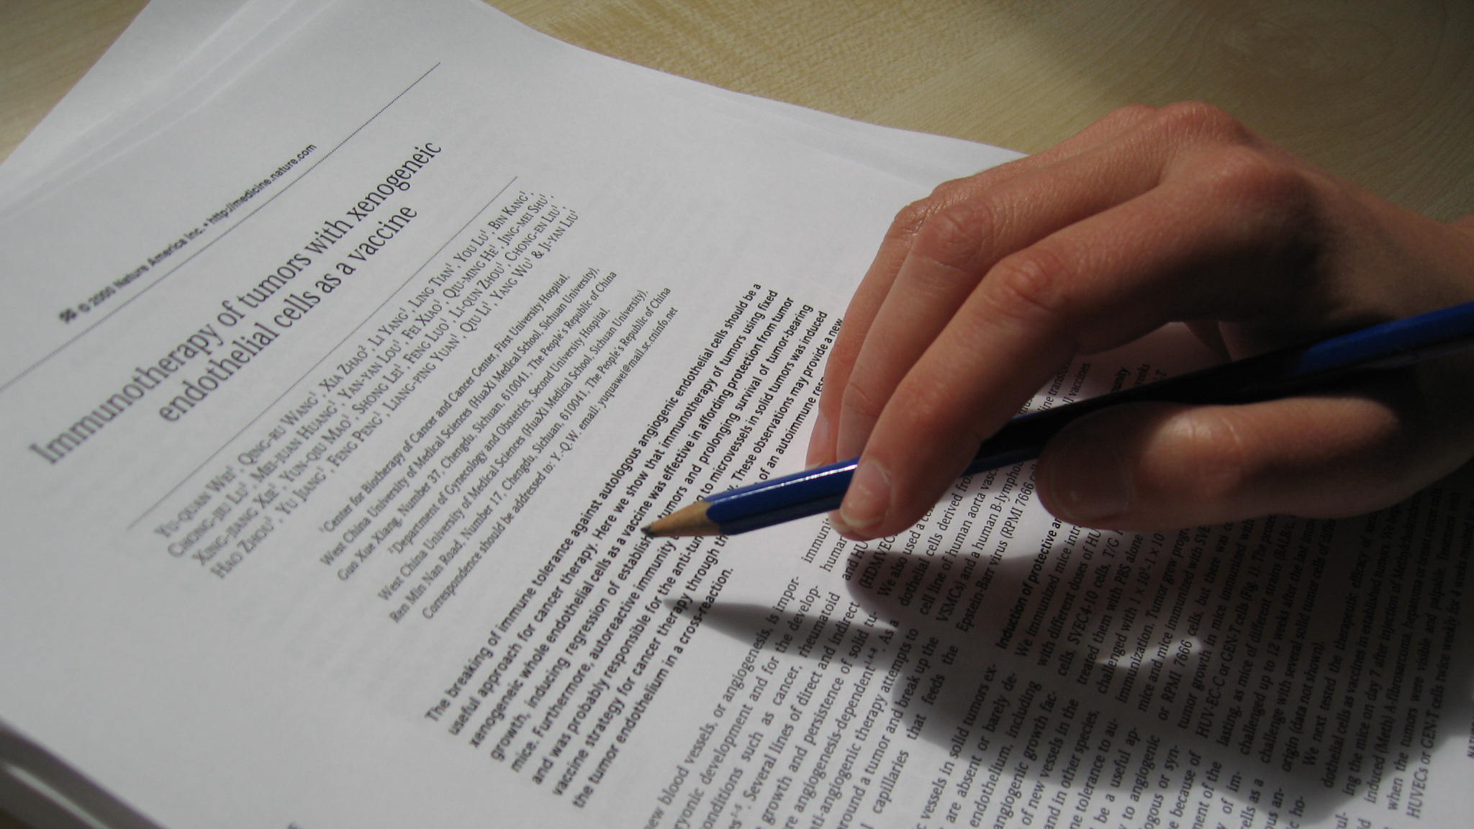
Research Paper: Revise the First Draft
PRINT IT OUT, so you can write on it.
  You cannot effectively revise on a computer.
Try to set aside your draft for a day or two before revising.
  This makes it easier to view your work objectively and see any gaps or problems.
Read your paper out loud.
  This sometimes makes it easier to identify writing that is awkward or unclear.
TeacherVision.com

Slide 7
Get some help…
Have somebody else read the paper and tell you if there's anything that's unclear or confusing.
TeacherVision.com

Slide 8

How to Revise
Print your paper out.
Read it paragraph by paragraph, using the two-step method discussed below.
Using a pen (a color other than black), write down what you need to change.
After reading the entire thing, go back and make the changes you need to make.

Slide 9

How to Revise
Look at your outline and see if you followed it.
If you did, do you need to add anything that is not on your outline.
If you did not, is what you wrote better than what you outlined.
Read it out loud… Does it sound good!

Slide 10

Revising…
A two-step Process

Slide 11
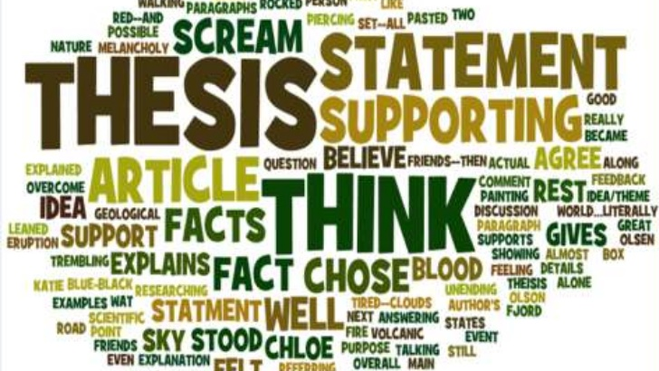
Thesis Statement…

Slide 12
Did My Thesis Work?
Remember, your paper should explain your thesis statement…
So, the paper should be about your THESIS!!!

Slide 13
Did My Thesis Work?
Introduction
Do I tell the readers my thesis clearly? How?
If the answer is no to the question, FIX IT!

Slide 14
Did My Thesis Work?
Body Paragraphs
Go one by one for each paragraph…
Does this paragraph explain my thesis? How?
Does this paragraph make my readers think about changing their mind to think like me? How?
If the answer is no to either question, FIX IT!

Slide 15
Did My Thesis Work?
Counterargument
Does my counterargument say the opposite of what my thesis is saying? Why?
Does my refutation prove my thesis is correct after all? Why?
Does my counterargument make sense for what my thesis is implying? Why?
If the answer is no to any question, FIX IT!

Slide 16
Did My Thesis Work?
Conclusion
Does my conclusion refer to my thesis is some way? How?
Does my conclusion leave my readers thinking about what I said in my thesis? How?
If the answer is no to either question, FIX IT!

Slide 17
Did My Thesis Work?
Overall
01
Did I prove my thesis in my paper? How?
02
Will my readers see the point I was trying to make with my thesis? Why?
03
Do I give my readers a recap of what my thesis was and how I proved it? How?
04
If the answer is no to any question, FIX IT!
05

Slide 18

Answer the question: Why?
This Photo by Unknown Author is licensed under CC BY-SA

Slide 19
Ask Why?
Your paper must answer the question WHY?
Why did you say that?
Why did you say it in that order?
Why is this the answer?
WHY? WHY? WHY? WHY? WHY? WHY? WHY? WHY? WHY? WHY? WHY? WHY?
You must explain everything!!!!

Slide 20
Ask Why?
Introduction
Why would anyone want to read any further after reading this introduction?
If you cannot answer why, then… FIX IT!

Slide 21
Ask Why?
Body Paragraphs
Go one by one for each paragraph…
Why do I say that?
Why do I think that?
Why did I use this quote here?
Why does what I wrote after it explain why I used this quote here?
Does this paragraph explain my thesis? Why/Why not?
If you cannot answer why, then… FIX IT!

Slide 22
Ask Why?
Counterargument
Why did I choose this counterargument?
Why does it matter to the conversation I am having with my readers?
Do I refute (counter my counterargument) well enough to make it not make to my readers? Why/Why not?
Why does my refutation matter?
If it is not what you want them to do, then FIX IT!

Slide 23
Ask Why?
Conclusion
What would the reader do after reading this paper? Why?
If it is not what you want them to do, then FIX IT!

Slide 24
Ask Why?
Overall
01
What will the reader’s impression of me be after reading this? Why?
02
What will the reader think about this topic after reading? Why?
03
If you did not, then FIX IT!
04
Did I explain everything? Why?
05
If you did not, then FIX IT!
06

Slide 25
Ask Why?
Overall
01
Did I over explain anything? Do I need to delete anything? Why?
02
If you do, then FIX IT!
03
Will my readers think what I want them to think? Why?
04
If it is not what you want them to think, then FIX IT!
05

Slide 26
In the End…
Your paper should sound better.
And Be better!

